Slide 1















Slide 2







MECHANIC
NURSE
SINGER
POSTMAN
PAINTER
VET

Slide 3





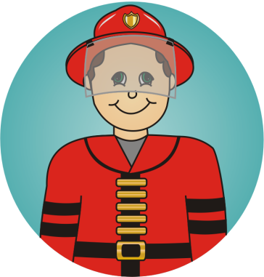

POLICEMAN
FARMER
DOCTOR
FIREMAN
TEACHER
COOK

Slide 4











?

Slide 5


?

Slide 6





?

Slide 7


?

Slide 8


?

Slide 9


?

Slide 10



?

Slide 11



?

Slide 12



?

Slide 13



?

Slide 14



?

Slide 15



?

