Slide 1
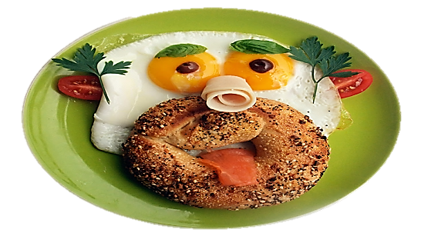
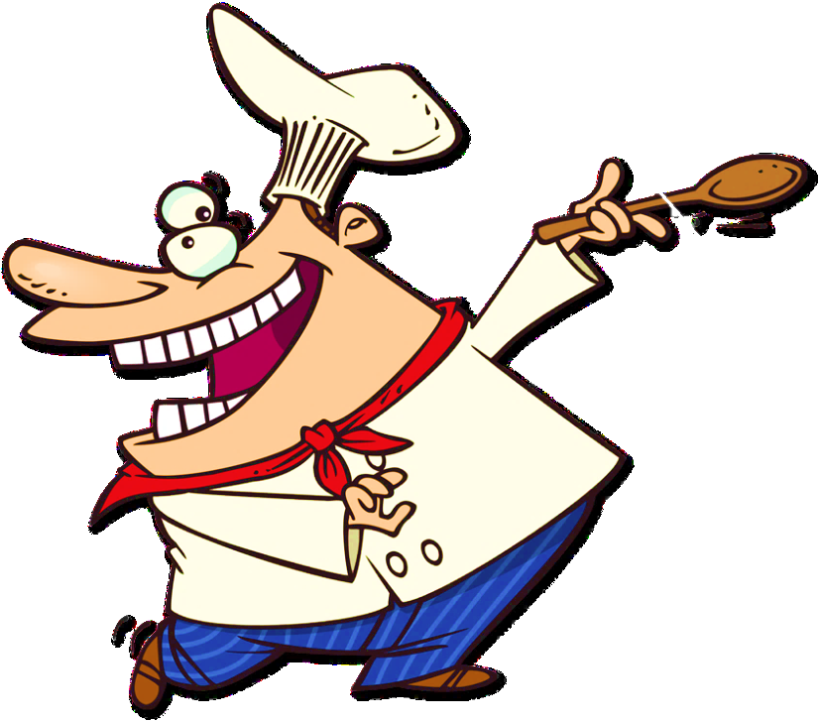
FOOD VOCABULARY REVIEW
START

Slide 2
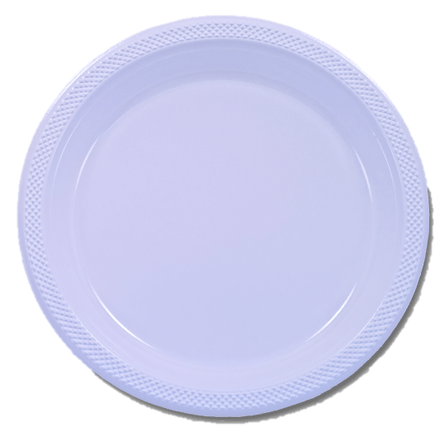
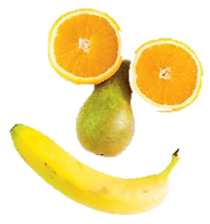
Click the fruit that the chef used to cook this meal
The eyes are made of orange.
The nose is a pear.
The mouth is a banana.
peach
orange
grapes
banana
plum
pear
Describe the picture
CHECK

Slide 3
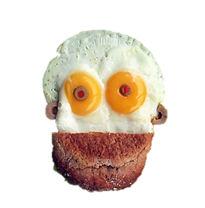
Click three ingredients that the chef used to cook this meal
The head is made of eggs.
The eyes and the ears
are olives.
The mouth is made of bread.
eggs
onion
bread
olives
garlic
potato
Describe the picture
CHECK

Slide 4
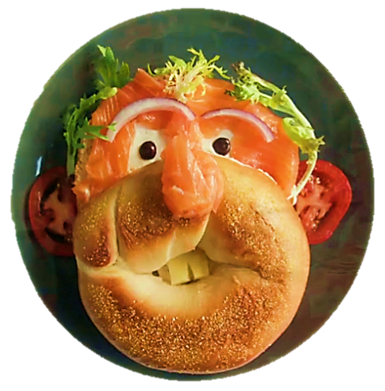
Click six ingredients that the chef used to cook this meal
The face is made of salmon
and bread.
The hair is made of parsley.
The ears are made of tomato.
The eyebrows are made of onion.
The teeth are made of cheese.
salmon
garlic
bread
tomato
onion
potato
parsley
cheese
Describe the picture
CHECK

Slide 5
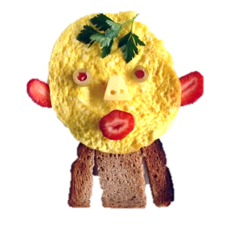
Click five ingredients that the chef used to cook this meal
The head is made of eggs.
The eyes are olives.
The mouth and the ears
are made of strawberry.
The nose is made of cheese.
The hair is made of parsley.
The eyes are made of olive.
The body is made of bread.
eggs
garlic
bread
strawberry
cheese
potato
parsley
olives
Describe the picture
CHECK

Slide 6
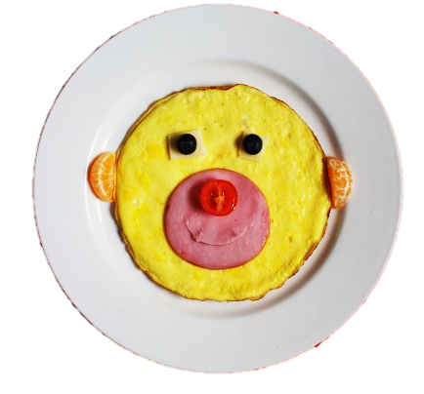
Click the ingredients that the chef used to cook this meal
The face is made of eggs.
The eyes are made of olive.
The ears are made of tangerine.
The mouth is made of sausage.
The nose is made of tomato.
onion
eggs
tomato
sausage
olive
bread
tangerine
Describe the picture
CHECK

